Slide 1
CIS 9557 – Business Analytics
Week 5 Multiple Linear Regression
Prof. Arturo Castellanos
CIS Department Office: VC11-B242

Slide 2
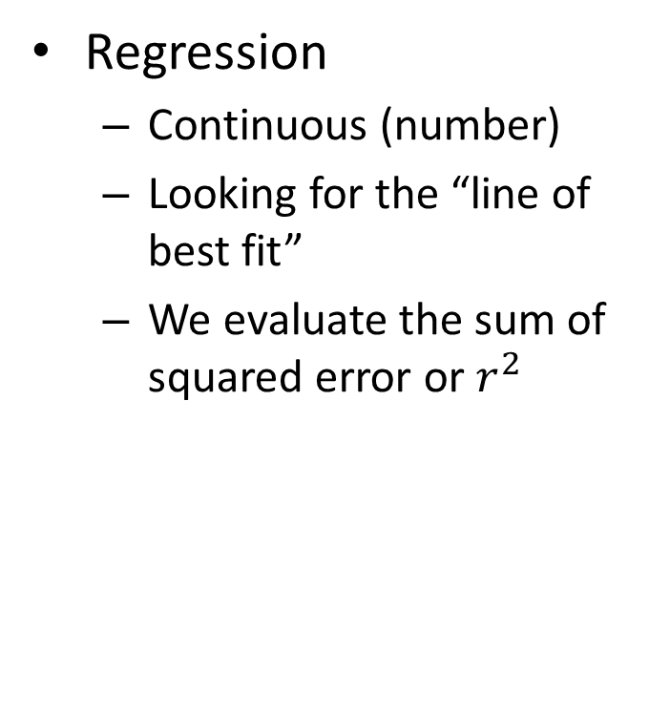
Comparing Classification and Regression
Classification
Discrete (class labels)
Looking for a decision boundary
We evaluate the accuracy
Regression
Continuous (number)
Looking for the “line of best fit”
We evaluate the sum of squared error or $r^{2}$

Slide 3
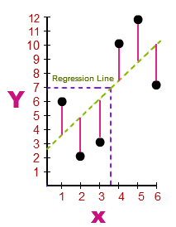
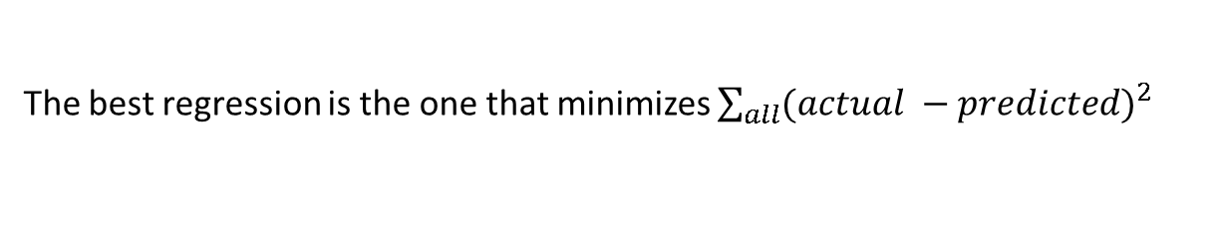
The goal is to minimize the errors from the actual data to the regression line. The least squares line minimizes the sum of the square of the errors.
The actual data points (x,y) in blue.
The Regression Line of the dependent (y) variable based on the independent (x) variable is shown in black.
The errors (residuals) are the vertical distances between the observed values of y and the predictions of the "line of best fit," shown in red.
Source: https://math.tutorvista.com/
The best regression is the one that minimizes $\sum_{all}{{(actual −predicted)}^{2}}$
Training points
Predictions from regression
y = mx + b

Slide 4

One of the drawbacks for using SSE, however, is that it increases as the number of data points increase.
Potential solution: R-squared
R² describes the proportion of variance of the dependent variable explained by the regression model. If the regression model is “perfect”, R² is 1.
How much of the change in the output (y) is explained by the change in my input (x). 0 < R² < 1. Not affected by the number of data points.

Slide 5

We assume a linear relationship between predictors and outcome:
outcome
coefficients
constant
error (noise)
predictors
Each regression coefficient is the amount of change in the outcome variable that would be expected per one-unit change of the predictor, if all other variables in the model were held constant.

Slide 6
Topics
Explanatory vs. predictive modeling with regression
Example: prices of Toyota Corollas
Fitting a predictive model
Assessing predictive accuracy
Selecting a subset of predictors

Slide 7
Explanatory Modeling
Goal: Explain relationship between predictors (explanatory variables) and target
Familiar use of regression in data analysis
Model Goal: Fit the data well and understand the contribution of explanatory variables to the model
“goodness-of-fit”: R², residual analysis, p-values

Slide 8
Predictive Modeling: Prices of Toyota Corolla ToyotaCorolla.xls
Goal: predict prices of used Toyota Corollas based on their specification
Data: Prices of 1436 used Toyota Corollas, with their specification information
Source: Shmueli, G., Bruce, P. C., Yahav, I., Patel, N. R., & Lichtendahl Jr, K. C. (2017). Data mining for business analytics: concepts, techniques, and applications in R. John Wiley & Sons. [Chapter 6 – Linear Regression]

Slide 9
Variables Used
Price in Euros
Age in months as of 8/04
KM (kilometers)
HP (horsepower)
CC (cylinder volume)
Doors
Quarterly_Tax (road tax)
Weight (in kg)
Source: Shmueli, G., Bruce, P. C., Yahav, I., Patel, N. R., & Lichtendahl Jr, K. C. (2017). Data mining for business analytics: concepts, techniques, and applications in R. John Wiley & Sons. [Chapter 6 – Linear Regression]

Slide 10
Data Sample (showing only the variables to be used in analysis)
Source: Shmueli, G., Bruce, P. C., Yahav, I., Patel, N. R., & Lichtendahl Jr, K. C. (2017). Data mining for business analytics: concepts, techniques, and applications in R. John Wiley & Sons. [Chapter 6 – Linear Regression]

Slide 11
Preprocessing
Fuel type is categorical (in R - a factor variable), must be transformed into binary variables. R’s lm function does this automatically.
Diesel (1=yes, 0=no)
Petrol (1=yes, 0=no)
None needed* for “CNG” (if diesel and petrol are both 0, the car must be CNG)
*You cannot include all the binary dummies; in regression this will cause a multicollinearity error. Other data mining methods can use all the dummies.

Slide 12
Results
Variable Selection
Train/Test (Why we do it)
Evaluation
Add variables (Measure performance)

Slide 13
Preprocessing – If we want to add categorical variables
Fuel type is categorical, must be transformed into binary variables
Diesel (1=yes, 0=no)
CNG (1=yes, 0=no)
None needed for “Petrol” (reference category)

Slide 14
Forward Selection
Start with no predictors
Add them one by one (add the one with largest contribution)
Stop when the addition is not statistically significant

Slide 15
Backward Elimination
Start with all predictors
Successively eliminate least useful predictors one by one
Stop when all remaining predictors have statistically significant contribution

Slide 16
Fitting a Regression Model to the Toyota Data
# reduce data frame to the top 1000 rows and select columns for
regression analysis
car_df = pd.read_csv('ToyotaCorolla.csv')
car_df = car_df.iloc[0:1000]
predictors = ['Age_08_04', 'KM', 'Fuel_Type', 'HP', 'Met_Color',
'Automatic', 'CC', 'Doors', 'Quarterly_Tax', 'Weight'] outcome = 'Price'
# partition data
X = pd.get_dummies(car_df[predictors], drop_first=True)
y = car_df[outcome]
train_X, valid_X, train_y, valid_y = train_test_split(X, y, test_size=0.4,
random_state=1)
car_lm = LinearRegression()
car_lm.fit(train_X, train_y)
put 40% in validation (test) partition

Slide 17
Output of the Regression Model
# print coefficients
print(pd.DataFrame({'Predictor': X.columns, 'coefficient':
car_lm.coef_}))
Partial Output
Predictor coefficient
0 Age_08_04 -140.748761
1 KM - 0.017840
2 HP 36.103419
3 Met_Color 84.281830
4 Automatic 416.781954
5 CC 0.017737
6 Doors -50.657863
7 Quarterly_Tax 13.625325
8 Weight 13.038711
9 Fuel_Type_Diesel 1066.464681
10 Fuel_Type_Petrol 2310.249543

Slide 18
Summary
Linear regression models are popular both for the explanatory power and prediction accuracy
A good predictive model has high predictive accuracy (to a useful practical level)
Predictive models are built using a training data set, and evaluated on a separate validation data set
Removing redundant predictors is key to achieving predictive accuracy and robustness
Subset selection methods help find “good” candidate models. These should then be run and assessed.

